Slide 1


SAVEETHA SCHOOL OF ENGINEERING SAVEETHA INSTITUTE OF MEDICAL AND TECHNICAL SCIENCES
IMPLEMENTATION OF CODE GENERATOR
SUBMITTED BY
Ch.Durga Narendra(192211285)
V.Poojitha (192210132)
B.Vineetha (192210143)
DEPARTEMENT OF CSE
SAVEETHA SCHOOL OF ENGINEERING SIMATS,CHENNAI-602105.
GUI DED BY
DR.G.MICHAEL PROFESSOR DEPARTMENT OF CSE
SAVEETHA SCHOOL OF ENGINEERING SIMATS,CHENNAI-602105.

Slide 2

Introduction to Phases of Compiler
Phases of compiler are invaluable tools for understanding the fundamental principles of compilation.
They provide a practical hands-on approach to the intricate process of translating source code into executable machine instructions.

Slide 3
Lexical Analyzer
Lexical analysis, often referred to as scanning, is the initial step in compilation. It involves breaking down the input source code into meaningful units, known as tokens.
Tokens represent fundamental building blocks of a program, such as keywords, identifiers, operators, and literals.
Tokenization
The process of identifying and classifying tokens from the input stream is known as tokenization.
Symbol Table
A symbol table is a data structure used to store information about the tokens, such as their type and location in the code.
Error Handling
Lexical analysis includes error handling to identify and report invalid tokens that do not conform to the language's grammar.

Slide 4
Parsing Tree
Top-Down Parsing
Top-down parsing algorithms start from the root of the parse tree and attempt to derive the input string.
Bottom-Up Parsing
Bottom-up parsing algorithms start from the input string and attempt to reduce it to the root of the parse tree.
Context-Free Grammar
Parsers typically rely on context-free grammar rules to define the syntax of the programming language.

Slide 5
Abstract Syntax Tree (AST) Generation
An Abstract Syntax Tree (AST) is a tree representation of the program's structure that captures its essential meaning while omitting syntactic details.
It serves as an intermediate representation that facilitates subsequent phases of compilation.
Tree Nodes
Each node in the AST represents a syntactic construct, such as an expression, statement, or declaration.
Parent-Child Relationships
The relationships between nodes in the AST reflect the hierarchical structure of the program, where parent nodes represent higher-level constructs.
Semantic Information
The AST may include semantic information about the program, such as type information and variable bindings.

Slide 6
Type Checking
Type checking is a crucial phase of compilation that ensures the consistency and correctness of the program's data types.
It involves verifying that operations are performed on compatible data types and that variables are used according to their declared types.
Static Type Checking
Static type checking is performed at compile time, before the code is executed.
Dynamic Type Checking
Dynamic type checking is performed at runtime, while the code is executing.
Type Inference
Type inference is a technique that automatically determines the types of variables and expressions based on their usage.

Slide 7
Intermediate Representation
An intermediate representation (IR) is a low-level representation of the program that is closer to machine code than source code but still abstract enough to be platform-independent.
It facilitates optimization and code generation.
Three-Address Code
Linear sequence of instructions with at most three operands per instruction.
Control Flow Graphs
Graphical representation of the program's control flow, showing basic blocks and their connections.
Static Single Assignment (SSA)
IR where each variable is assigned a value only once.

Slide 8
Code Generation
Code generation is the final phase of compilation, where the intermediate representation is translated into executable machine code for the target platform. This process involves mapping IR instructions to corresponding machine instructions.
Instruction Selection
Selecting the appropriate machine instructions to implement the IR instructions.
Register Allocation
Assigning machine registers to variables and temporary values.
Code Optimization
Applying optimization techniques to improve the performance of the generated code.

Slide 9
Optimization Techniques
Optimization techniques are applied during the compilation process to improve the performance and efficiency of the generated code. These techniques aim to reduce code size, execution time, and resource consumption.
Instruction Scheduling
Reordering instructions to improve their execution efficiency.
Data Locality Optimization
Placing data closer to the processor to reduce memory access time.
Loop Optimization
Optimizing loops by unrolling, invariant code motion, and other techniques.
Dead Code Elimination
Removing code that is never executed.

Slide 10
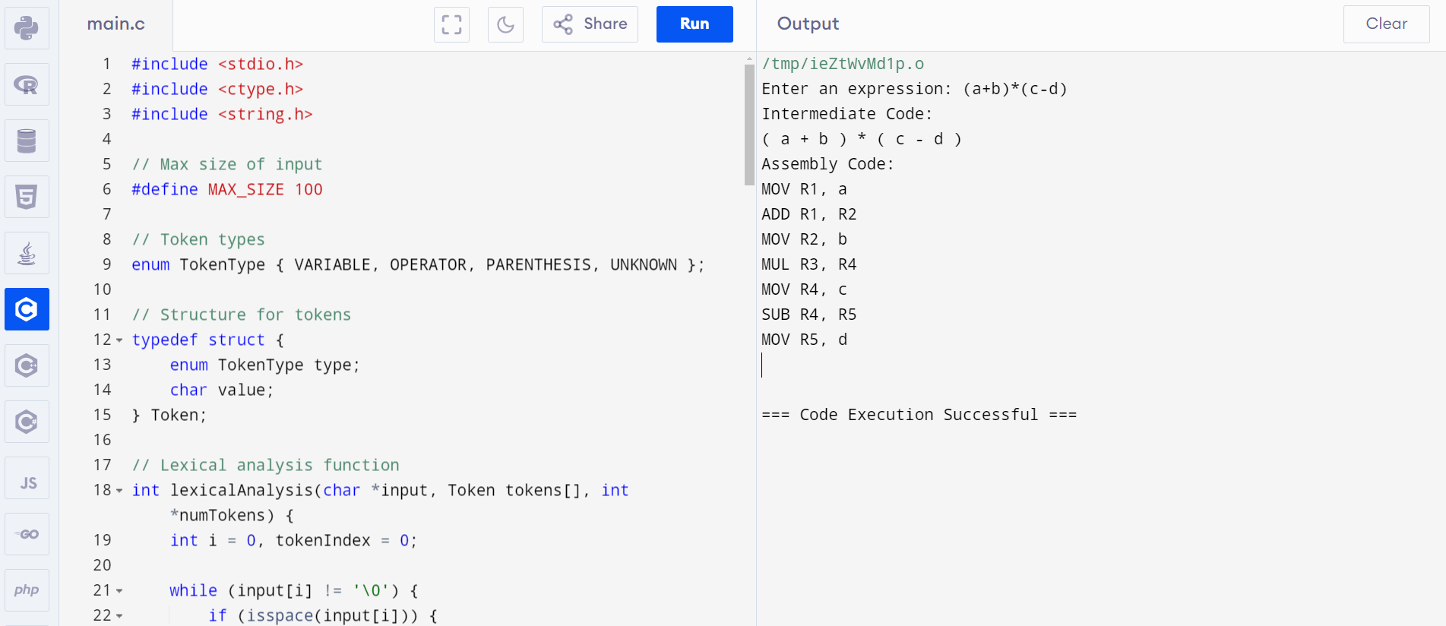
Code

Slide 11
Limitations and Assumptions
Limited Language Features
Simplified compilers may not support all features of the target language, such as recursion, complex data structures, or dynamic memory allocation.
Input Size Restrictions
Simplified compilers may impose restrictions on the size of the input program to simplify the implementation and reduce memory requirements.
Limited Optimization
Optimization techniques in simplified compilers are often basic and may not achieve the same level of performance improvement as production-grade compilers.

Slide 12
Conclusion and Future Enhancements
Simplified compilers provide a valuable foundation for understanding the compilation process and its intricacies. They serve as an excellent starting point for learning about the design and implementation of real-world compilers.
Future enhancements could include expanding the supported language features, implementing more advanced optimization techniques, and incorporating error recovery mechanisms.
Integrating artificial intelligence techniques, such as machine learning, could enhance compiler optimization and code generation.

Slide 13


